Slide 1
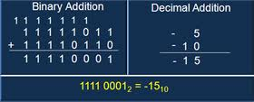
S01 - Data Types
Required: PM: Ch 3, pgs 27-35
PM: Ch 5.1-6, pgs 47-56
Code: Chs 1-9, 20 Recommended: Wiki: Signed Numbers Two's Complement Wiki: Two's_complement Wiki: Fixed Point Floating Point

Slide 2
CS 224
Chapter | Lab | Homework
S00: Introduction
Unit 1: Digital Logic
S01: Data Types S02: Digital Logic | L01: Warm-up L02: FSM | HW01 HW02
Unit 2: ISA
S03: ISA S04: Microarchitecture S05: Stacks / Interrupts S06: Assembly | L03: Blinky L04: Microarch L05b: Traffic Light L06a: Morse Code | HW03 HW04 HW05 HW06
Unit 3: C
S07: C Language S08: Pointers S09: Structs S10: I/O | L07b: Morse II L08a: Life L09b: Snake | HW07 HW08 HW09 HW10

Slide 3
Data Types Learning Outcomes…
Students will be able to:
Represent an integral decimal number as an unsigned or signed 1’s and 2’s complement integer, signed magnitude number, and ASCII character.
Represent a fractional decimal number in fixed point and floating point formats.
Convert a binary number to decimal format.
Convert a decimal number to binary format.
Articulate the use of computer word size, endianess, sign extension, and number overflow in developing computer programs.

Slide 4
Need to Know…
Binary Digital System
Hexadecimal Numbers
Integral Data Types
Unsigned
Sign magnitude
1’s & 2’s complement
Overflow
Word Size
Sign-extension
Decimal to binary conversion
Fractional Data Types
Fixed Point
Floating Point
ASCII Characters
Casting, Endianess

Slide 5
What are Decimal Numbers?
Digital Binary System
“Decimal” means that we have ten digits to use in our representation of numbers
Symbols 0 through 9
Positional notation
Most widely used by modern civilizations
What is 3,546?
3 thousands + 5 hundreds + 4 tens + 6 ones.
3,546₁₀ = 3×10³ + 5×10² + 4×10¹ + 6×10⁰
How about negative numbers?
Need additional symbol(s)

Slide 6
What are Binary Numbers?
Digital Binary System
“Binary” means that we have two digits to use in our representation of numbers
Symbols 0 and 1
Positional notation
More adaptable for computers
What is the decimal value of binary 1011?
1 eights + 0 fours + 1 twos + 1 ones
1011₂ = 1×2³ + 0×2² + 1×2¹ + 1×2⁰
How about negative numbers?
We don’t want to add additional symbols
So…

Slide 7
Binary Digital System
Digital Binary System
What is a Binary Digital System?
Binary (base 2) means there are two states, 0 and 1.
Digital means there are a finite number of symbols.
Basic unit of information is the binary digit, or bit.
How are bits represented?
Voltages
Residual magnetism
Light
Polarization
What about more than two states?
A collection of 2 bits has 4 possible states: 00, 01, 10, 11
A collection of 3 bits has 8 possible states: 000, 001, 010, 011, 100, 101, 110, 111
A collection of n bits has 2^{n} possible states.

Slide 8
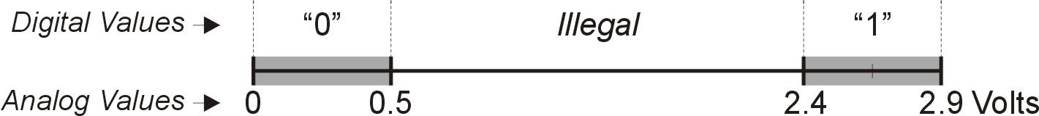
Electronic Representation of a Bit
Digital Binary System
Analog processing relies on exact physical values which are affected by temperature, age, etc.
Analog values are never quite the same.
Each time you play a vinyl album, it will sound a bit different.
Bits rely on approximate physical values which are not affected by age or temperature.
Music that never degrades.
Pictures that never get dusty or scratched.
Computers rely only on approximate physical values.
A logical ‘1’ is a relatively high voltage (2.4V - 5V).
A logical ‘0’ is a relatively low voltage (0V – 0.5V).

Slide 9
Binary Nomenclature
Digital Binary System
By using groups of bits, we can achieve high precision.
8 bits => each bit pattern represents 1/256.
16 bits => each bit pattern represents 1/65,536
32 bits => each bit pattern represents 1/4,294,967,296
64 bits => each bit pattern represents 1/18,446,744,073,709,550,000
IEC International Standard names and symbols for binary prefixes:
SI Name (Symbol) | Value | Binary | Value
Byte (B) | 10⁰ |  | 2⁰ | 1 byte
Kilobyte (kB) | 10³ | Kibibyte | 2¹⁰ | 1024 bytes
Megabyte (MB) | 10⁶ | Mebibyte | 2²⁰ | 1,048,576 bytes
Gigabyte (GB) | 10⁹ | Gibibyte | 2³⁰ | 1,073,741,824 bytes
Terabyte (TB) | 10¹² | Tebibyte | 2⁴⁰ | 1,099,511,627,776 bytes
Petabyte (PB) | 10¹⁵ | Pebibyte | 2⁵⁰ | 1,125,899,906,842,624 bytes
Exabyte (EB) | 10¹⁸ | Exbibyte | 2⁶⁰ | 1,152,921,504,606,846,976 bytes
Zettabyte (ZB) | 10²¹ | Zebibyte | 2⁷⁰ | 1,180,591,620,717,411,303,424 bytes
Yotabyte (YB) | 10²⁴ | Yobibyte | 2⁸⁰ | 1,208,925,819,614,629,174,706,176 bytes

Slide 10
Hexadecimal Notation
Hexadecimal
Binary is hard to read (very verbose)
Hexadecimal is a common alternative
16 digits are 0123456789ABCDEF
Binary Hex
0000 0 0001 1 0010 2 0011 3 0100 4 0101 5 0110 6 0111 7 1000 8 1001 9 1010 A 1011 B 1100 C 1101 D 1110 E 1111 F
0100 0111 1000 1111 = 0x478F
1101 1110 1010 1101 = 0xDEAD
1011 1110 1110 1111 = 0xBEEF
1010 0101 1010 0101 = 0xA5A5
Separate binary code into groups of 4 bits (starting from the right)
Translate each group into a single hex digit
0x is a common
prefix for writing
numbers which means
hexadecimal

Slide 11
Data Types
Data Types
What kinds of data do computers use?
Numbers – signed, unsigned, integers, floating point, complex, rational, irrational, …
Text – characters, strings, …
Images – pixels, colors, shapes, …
Sound – pitch, amplitude, …
Logical – true / false, open / closed, on / off, …
Instructions – programs, …
…
What is a Data type?
How is the data is represented
What operations are valid for the data

Slide 12
Some Important Data Types
Data Types
Unsigned integers
Only non-negative numbers
0, 1, 2, 3, 4, …
Signed integers
Negative, zero, positive numbers
…, -3, -2, -1, 0, 1, 2, 3, …
Fixed point numbers
Bounded negative, zero, positive numbers w/fraction
-2.5, 0.0, 100.125, …
Floating point numbers
Unbounded negative, zero, positive numbers w/fraction
PI = 3.14159 x 10⁰
Characters
8-bit, unsigned integers
‘0’, ‘1’, ‘2’, … , ‘a’, ‘b’, ‘c’, … , ‘A’, ‘B’, ‘C’, … , ‘@’, ‘#’,

Slide 13
Integral Data Types

Slide 14
Unsigned Integers
Unsigned
Computers use weighted positional notation
most
significant
least
significant
329
101
10²
10¹
10⁰
2²
2¹
2⁰
3x100 + 2x10 + 9x1 = 329
1x4 + 0x2 + 1x1 = 5
What do these unsigned binary numbers represent?
0000
0110
0
1111
1010
15
0001
1000
1
0111
1100
7
1011
1001
11
6
10
8
12
9

Slide 15
Unsigned Binary Arithmetic
Unsigned
Base 2 addition – just like base 10!
add from right to left, propagating carry
carry
10010 10010 1111
+ 1001 + 1011 + 1
10111
+ 111
1
1
0
1
1
1
1
1
0
1
1
0
0
0
0
1
1
1
1
0
Subtraction, multiplication, division,…

Slide 16
Quiz 1.1
Convert the following unsigned binary numbers to their decimal equivalent:
Number₂ | Number₁₀
00010101
11111111
01111111

Slide 17
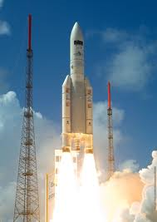
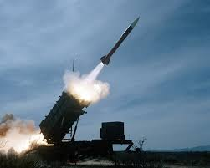
Data Types Matter!
On June 4, 1996 an unmanned Ariane 5 rocket launched by the European Space Agency exploded just forty seconds after lift-off. The rocket was on its first voyage, after a decade of development costing $7 billion. The destroyed rocket and its cargo were valued at $500 million.
On February 25, 1991, during the Gulf War, an American Patriot Missile battery in Dharan, Saudi Arabia, failed to intercept an incoming Iraqi Scud missile. The Scud struck an American Army barracks and killed 28 soldiers.
Source: http://www.ima.umn.edu/~arnold/455.f96/disasters.html

Slide 18

Data Types Matter!
On July 23, 1983, at 41,000 feet somewhere over the Canadian countryside, Air Canada 143 suddenly was without fuel, despite its computers indicating there was plenty of fuel remaining in multiple tanks. With its fuel gone, so were its electrical and hydraulic systems and 767 jumbo jet had just become roughly the equivalent of a flying brick.
Fuel loading was miscalculated due to a misunderstanding of the recently adopted metric system which replaced the imperial system.
Source: http://en.wikipedia.org/wiki/Gimli_Glider

Slide 19
Signed Integers
Signed
Integers of n bits have 2^{n} distinct values
Signed integer assign about half to positive integers (1 through 2^{n-1}) and about half to negative (- 2^{n-1} through -1)
that leaves two values: one for 0, and one extra
MSB indicates sign: 0=positive, 1=negative
Examples: Sign-magnitude, 1’s complement, and 2’s complement
Positive signed integers are treated just like unsigned – zero in most significant bit (MSB)
00101 = 5
Negative signed integers have a one in the MSB
sign-magnitude – 10101 = -5
one’s complement – 11010 = -5
two’s complement – 11011 = -5

Slide 20
Sign-Magnitude Integers
Signed
Representations
01111_{binary} ⇒ 15_{decimal}
11111 ⇒ -15
00000 ⇒ 0
10000 ⇒ -0
Range
-(2^{(n-1)}-1) to 2^{(n-1)}-1
Problems
Two representations of zero (+0 and –0)
Arithmetic circuits are complex and cumbersome
Negation/absolute value operations are easy, but addition/subtraction operations are difficult.
To negate a number,
toggle the sign bit.
Left-bit encodes sign:
0 = + (or 0)
1 = - (or 0)
Notes:
Sign-Magnitude
Consists of an n bit unsigned magnitude and a sign bit. The definition of the sign bit is:
0: the integer is positive or zero; 1: the integer is negative or zero.
The integer represented in (n+1) bit sign-magnitude is
The range of values for an (n+1) bit sign-magnitude integer is to .
The format of an 8-bit sign-magnitude number is:
Some examples of 8-bit sign-magnitude numbers are shown below:
The range of an 8-bit sign-magnitude integer is -127 to +127.
There are different sign-magnitude representations for +0 and -0.
Sign reversal and absolute value operations are easy using sign-magnitude representation.
Adding the negative of a number is not the same as subtraction in sign-magnitude. Different operations must be defined for addition and subtraction with sign-magnitude numbers.

Slide 21
1’s Complement Integers
Signed
Representations
00110_{binary} ⇒ 6_{decimal}
11001 ⇒ -6
00000 ⇒ 0
11111 ⇒ -0
Range
-(2^{(n-1)}-1) to 2^{(n-1)}-1
Problems
Two representations of zero (+0 and –0)
Arithmetic circuits use binary addition with end-around carry (ie. resulting carry out of the most significant bit of the sum is added to the least significant bit of the sum.)
To negate a number,
invert number bit-by-bit.
Left-bit encodes sign:
0 = + (or 0)
1 = - (or 0)
Notes:
One's Complement
In one's complement representation subtraction is performed by addition of a negative integer. This eliminates the need for a separate subtraction processor. As in sign-magnitude, the leftmost bit indicates the sign of an integer in complement representation. The representation for positive integers is the same as unsigned with the leftmost bit = 0.
Negative integers are formed by reversing all bits to form the bitwise complement of a positive integer. If I is the (n+1) bit binary sequence:
then -I in one's complement is given by:
where for all i.
Let I be a negative one's complement integer. The value of I is obtained by forming its one's complement:
since . Thus,
Negative one's complement integers are formed by subtracting a bias of from the positive integers. Taking into account the sign bit , the value for a positive or negative (n+1) bit one's complement integer is:
The range of values for an (n+1) bit one's complement integer is to .
Since the complement of 0 is , there are different representations for +0 and -0 in one's complement.
Examples of 8-bit one's complement numbers:
The range of 8-bit one's complement integers is -127 to +127.
Addition of signed numbers in one's complement is performed using binary addition with end-around carry. If there is a carry out of the most significant bit of the sum, this bit must be added to the least significant bit of the sum.
To add decimal 17 to decimal -8 in 8-bit one's complement:

Slide 22
2’s Complement Integers
Signed
To negate a number,
1’s complement + 1.
Left-bit encodes sign:
0 = + (or 0)
1 = -
Representation
00110_{binary} ⇒ 6_{decimal}
11010 ⇒ -6
00000 ⇒ 0
11111 ⇒ -1
Range
–2^{(n-1)} to 2^{(n-1)}-1
Simplifies logic circuit construction
Addition is performed using simple binary addition
Bottom line: simpler/faster hardware units!
Notes:
Two's Complement
Two's complement representation has a single zero representation and eliminates the end-around carry operation required in one's complement addition. Positive two's complement integers have the same representation as unsigned numbers.
The additive inverse in two's complement is formed by taking the one's complement of a number and then adding 1 to the least significant bit.
Comparing this procedure to one's complement, it is easy to see that the value of an (n+1) bit two's complement integer is:
The range of values for an (n+1) bit two's complement integer is to .
Since the additive inverse of 0 is 0 in two's complement, the zero value has a unique representation.
To find the 8 bit two's complement representation of -8:
Examples of 8-bit two's complement numbers:
The range of 8-bit two's complement integers is -128 to +127.
Addition of signed numbers in two's complement is performed using simple binary addition.
To add decimal 17 to decimal -8 in 8-bit two's complement:
A carry out of the most significant bit is ignored in two's complement addition.

Slide 23
2’s Complement Integer
Signed
If number is positive or zero,
normal binary representation
If number is negative,
start with positive number
flip every bit (i.e., take the one’s complement)
then add one
00101 (5) 01001 (9)
11010 (1’s comp) (1’s comp)
+ 1 + 1
11011 (-5) (-9)
10110
10111

Slide 24
2’s Complement
Signed
Positional number representation with a twist
the most significant (left-most) digit has a negative weight
n-bits represent numbers in the range −2^{n−1} … 2^{n−1} − 1
What are these 2’s complement numbers?
0110 = 2² + 2¹ = 6
1110 = -2³ + 2² + 2¹ = -2
0000
0110
1111
1010
0001
0
1000
0111
1100
1011
1001
-8
6
7
-1
-4
-6
-5
1
-7

Slide 25
Quiz 1.2
What is the decimal number represented by the following binary digits?
Number₁₀
(unsigned)
10111₂
(sign magnitude)
(1's complement)
(2's complement)

Slide 26
2’s Complement Shortcut
Signed
To take the two’s complement of a number:
copy bits from right to left until (and including) the first “1”
flip remaining bits to the left
011010000 011010000
100101111 (1’s comp)
+ 1
100110000 100110000
(flip)
(copy)

Slide 27
2’s Complement Binary Addition
Signed
Rules of Binary Addition:
0 + 0 = 0
0 + 1 = 1
1 + 0 = 1
1 + 1 = 0, with carry
Two's complement addition follows the same rules as binary addition.
Two's complement subtraction is the binary addition of the minuend to the 2's complement of the subtrahend (adding a negative number is the same as subtracting a positive one).
5 + (-3) = 2 0000 0101 = +5
+ 1111 1101 = -3
--------- --
0000 0010 = +2
1111
0000
0001
1110
-1
0
1
0010
1101
-2
2
0011
-3
3
1100
-4
4
0100
1011
-5
5
0101
-6
6
1010
-7
-8
7
0110
1001
1000
0111
-
+

Slide 28
2’s Complement Overflow
Overflow
Overflow = the result doesn’t fit in the capacity of the representation
ALU’s are designed to detect overflow
It’s really quite simple
if the carry in to the most significant position (MSB) is different from the carry out from the most significant position (MSB), then overflow occurred.
Generally, overflow is only reported as a CPU status bit
NOTE: CARRY OUT IS NOT OVERFLOW!
carry
carry
00100110
+ 11101101
38
-19
19
00100110
+ 01101101
38
109
-109
100010011
010010011

Slide 29
2’s Complement Overflow
Overflow
1111
0000
0001
1110
0
0010
F
1
E
15
0
1
2
1101
14
-1
0
1
2
0011
D
-2
2
3
13
3
-3
3
1100
C
12
-4
4
4
4
0100
-5
5
11
5
B
-6
6
5
-7
-8
7
0101
1011
10
6
A
9
8
7
6
1010
9
8
7
0110
1001
1000
0111

Slide 30
Quiz 1.3
Fill in the 3 boxes using the appropriate data type arithmetic:
What data type uses the same arithmetic logic as an unsigned integer?
Which data type has the simplest arithmetic logic?
Signed-Magnitude
1’s Complement
2’s Complement
00100110
+ 11101101
00100110
+ 11101101
00100110
+ 11101101

Slide 31
Review: Numbers…
Review
Signed Magnitude
1’s Complement
2’s Complement
Un-signed
7
6
5
4
3
2
1
0
-1
-2
-3
-4
111
110
101
100
011
010
001
000
101₁₀ = 101
101_{unsigned} = 5
101_{signed magnitude} = -1
101_{1’s complement} = -2
101_{2’s complement} = -3
011
010
001
000, 100
101
110
111
011
010
001
000, 111
110
101
100
011
010
001
000
111
110
101
100
Range:
0 to 7
-3 to 3
-3 to 3
-4 to 3

Slide 32
2’s Complement Sign-Extension
Sign-Extension
You can make a number wider by simply replicating its leftmost bit as desired.
What is the decimal value of the following 2’s complement numbers?
6
0110 =
000000000000000110 =
1111 =
11111111111111111 =
1 =
6
-1
All the same!
(Sign-extended values)
-1
-1

Slide 33
Decimal to Binary Conversion
Conversions
Continually divide the number by 2 and prepend the remainders until zero.
2
43
0
1
0
1
0
1
1
2
21 R 1
2
10 R 1
1 × 2⁵ + 0 × 2⁴ + 1 × 2³ + 0 × 2² + 1 × 2¹ + 1 × 2⁰
32 + 0 + 8 + 0 + 2 + 1
= 43
2
5 R 0
2
2 R 1
2
1 R 0
0 R 1
Prepend a zero.
Do a 2’s complement to negate number:
-(0101011) = 1010101

Slide 34
Quiz 1.4
Convert the following decimal numbers to their 8-bit, 2’s complement binary number equivalent:
Number₁₀ | Binary (2’s complement)
5
123
-35

Slide 35
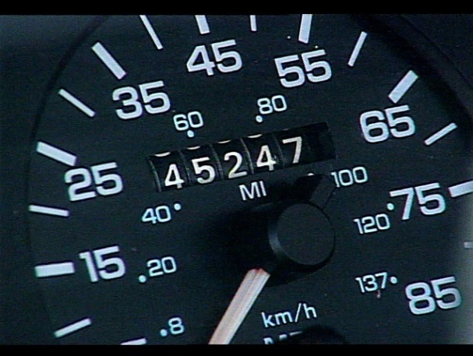
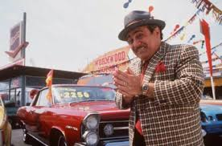
Pre-class Quiz…
What’s wrong with this C computer program?
What might be wrong with this picture?
int main()
{
unsigned char i, sum = 0;
for (i = 0; i < 1000; i++)
{
sum = sum + i;
}
}

Slide 36
Fractional Data Types

Slide 37
Fixed Point Numbers
Fixed Point
Bounded negative, zero, positive numbers w/fraction
Fractions are created by dividing a binary number into an integral and fractional part
The program is responsible for knowing the position of the “decimal point”
Signed or un-signed
Requires less processing resources than floating-point
-2⁹
2⁸
2⁷
2⁶
2⁵
2⁴
2³
2²
2¹
2⁰
2⁻¹
2⁻²
2⁻³
2⁻⁴
2⁻⁵
2⁻⁶
0
0
0
0
0
0
0
0
0
1
1
0
0
0
0
0
= 1.5
Whole or integral Part
Fractional Part
Decimal Point

Slide 38
Fixed Point Numbers
Fixed Point
0
0
0
0
0
0
0
0
1
0
1
0
0
0
0
0
Intregal part
Fractional part
With a fixed-point fractional part, we can have 5/2 = 2.5
The more bits you use in your fractional part, the more accuracy you will have.
Uses 2’s complement for negative numbers.
Accuracy is 2 ^{-(# fraction bits)}.
For example, if we have 6 bits in our fractional part (like the above example), our accuracy is 2⁻⁶ = 0.015625. In other words, every bit is equal to 0.015625

Slide 39
Fixed Point Arithmetic
Fixed Point
Fixed point addition:
0
0
0
0
0
0
0
0
1
0
1
0
0
0
0
0
Adding 2.5 + 2.5
+
0
0
0
0
0
0
0
0
1
0
1
0
0
0
0
0
0
0
0
0
0
0
0
1
0
1
0
0
0
0
0
0
= 5
Without fixed point math the result would have been 4 due to the truncation of the integer division.
Faster, easier than any other fractional data type.

Slide 40
Floating Point Numbers
Floating Point
Numbers such as π, e, cannot be expressed by a fixed number of significant figures.
Computers use a base-2 representation, they cannot precisely represent certain exact base-10 numbers.
Fractional quantities are typically represented in computer using “floating point” form, e.g.,
Number = -1^{s} × 1.fraction × 2^{(exponent – 127)}
Mantissa
0.5 <= m < 1
Base

Slide 41
Floating Point Numbers
Floating Point
Unbounded negative, zero, positive numbers w/fraction
Binary scientific notation
IEEE 754 Standard - 32 / 64 bit floating point
Exponent is biased by 127 (2^{e-1} – 1)
Implied leading 1 in mantissa (fraction or significand)
Zero represented by all 0’s
Denormalized, infinity, NaN
1
8
23
s
exponent
fraction
N = -1^{s} × 1.fraction × 2^{(exponent – 127)}

Slide 42
Normalizing Floating Point
Floating Point
Scientific Notation
0.00123 × 10³ = 1.23
0.01230 × 10² = 1.23
0.12300 × 10¹ = 1.23
Base 2 equivalences
0.011₂ × 2⁽¹²⁹⁻¹²⁷⁾ = .375 × 2² = 1.5
0.110₂ × 2⁽¹²⁸⁻¹²⁷⁾ = .75 × 2¹ = 1.5
1.100₂ × 2⁽¹²⁷⁻¹²⁷⁾ = 1.5 × 2⁰ = 1.5
Floating point normalization
Fraction is shifted left (decrementing exponent) until greater than 1 – then the 1 is dropped.
Allows for one more binary bit of precision.
1
8
23
s
exponent
fraction
N = -1^{s} × 1.fraction × 2^{(exponent – 127)}
1 is assumed
and not stored
in number.

Slide 43
Floating Point Numbers
Floating Point
What does this represent?
0 10000000 10000000000000000000000
Positive
Exponent is 128 – 127 = 1
Fraction is 1.1 = 2⁰ + 2⁻¹ = 1 + 1/2 = 1.5
The final number is 1.5 x 2¹ = 3.0
And this one?
1 10000001 10101000000000000000000
Negative
Exponent is 129 – 127 = 2
Fraction is 1.10101 = 2⁰ + 2⁻¹ + 2⁻³ + 2⁻⁵
= 1 + 1/2 + 1/8 + 1/32 = 1.65625
The final number is -1.65625 x 2² = -6.625

Slide 44
Quiz 1.5 – FP to Decimal
What is the decimal equivalent of the following signed, 16-bit (8 bit fraction), fixed point number?
-2⁷
2⁶
2⁵
2⁴
2³
2²
2¹
2⁰
2⁻¹
2⁻²
2⁻³
2⁻⁴
2⁻⁵
2⁻⁶
2⁻⁷
2⁻⁸
0
0
0
1
0
1
1
1
1
0
1
1
0
0
0
0
=
Integral Part
Fractional Part
What is the decimal equivalent of the following 32-bit floating point number?
1 10000011 11000000000000000000000 =
1
8
23
s
exponent
fraction
N = -1^{s} × 1.fraction × 2^{(exponent – 127)}

Slide 45
Decimal to Floating Point
Floating Point
1
8
23
Example: convert 22.625 to FP
1. Convert decimal 22 to binary:
22₁₀ = 10110₂
2. Convert decimal 0.625 to binary:
0.625₁₀ = 0.101₂
3. Combine integer and fraction:
10110.101₂ × 2⁰
4. Normalize:
10110.101₂ × 2⁰
1011.0101₂ × 2¹
101.10101₂ × 2²
10.110101₂ × 2³
1.0110101₂ × 2⁴
5. Bias exponent, drop the leading bit, and combine sign, exponent, and fraction:
0 10000011 01101010000000000000000
s
exponent
fraction
N = -1^{s} × 1.fraction × 2^{(exponent – 127)}
To convert a decimal number to binary IEEE 754 floating point:
Convert the absolute value of the decimal number to a binary integer plus a binary fraction.
Normalize the number in binary scientific notation to obtain fraction and exponent.
Bias exponent by 127, set s=0 for a positive number and s=1 for a negative number, and combine.

Slide 46
Quiz 1.6 – Decimal to FP
1. Convert the following decimal number to a 2’s complement, 16-bit (Q6.10) fixed point number.
-2⁵
2⁴
2³
2²
2¹
2⁰
2⁻¹
2⁻²
2⁻³
2⁻⁴
2⁻⁵
2⁻⁶
2⁻⁷
2⁻⁸
2⁻⁹
2⁻¹⁰
-25.8125 =
Integral Part
Fractional Part
HINT: 0.8125 = 1/2 + 1/4 + 1/16)
What is the IEEE 754 binary floating point equivalent of the following decimal number?
-37.375 =
 | 2^{(exponent – 127)} |  |  |  |  |  |  |  | (1).Fraction
HINT: 0.375 = 1/4 + 1/8)

Slide 47
FP Behavior
Programmer must be aware of accuracy limitations!
(1 + 10³⁰) + –10³⁰
10³⁰ – 10³⁰
0
=? 1 + (10³⁰ + –10³⁰)
=? 1 + 0
≠ 1
Operations not associative!
(1.0 + 6.0) ÷ 640.0
7.0 ÷ 640.0
.010937
=? (1.0 ÷ 640.0) + (6.0 ÷ 640.0)
=? .001563 + .009375
≠ .010938
×,÷ not distributive across +,-

Slide 48
Chopping vs. Rounding
Some machines use chopping, because rounding adds to the computational overhead. Since number of significant figures is large enough, resulting chopping error is usually negligible.
Base 10 pi=3.14159265358…
Chopped pi=3.141592 e_{t}=0.00000065
Rounded pi=3.141593 e_{t}=0.00000035

Slide 49
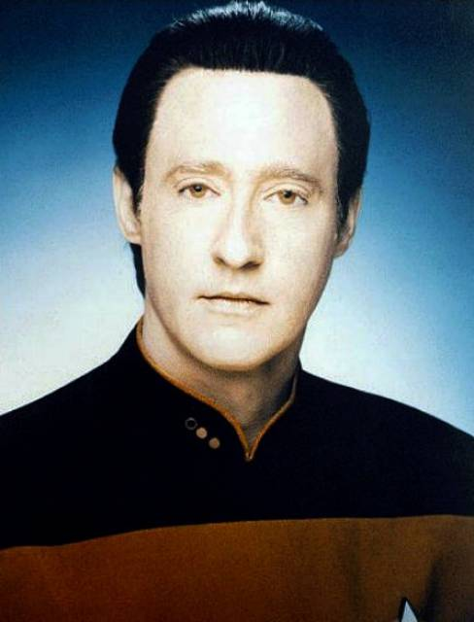
Other Data Types

Slide 50
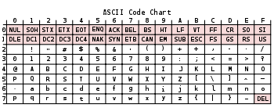
ASCII Codes
ASCII Characters
The American Standard Code for Information Interchange (ASCII) is a character-encoding scheme based on the ordering of the English alphabet.
Represent text in computers
7-bit, unsigned integers
1st 32 codes unprintable
Developed from teletype

Slide 51
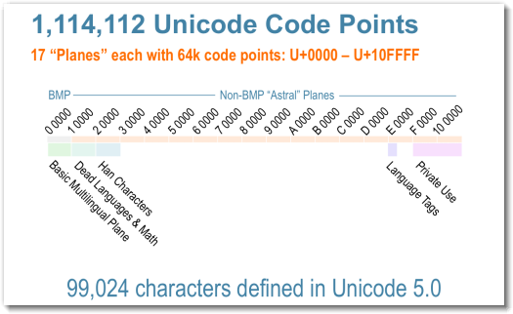
Unicode Codes
Unicode Characters
Unicode is a computing industry standard for the consistent encoding, representation and handling of text expressed in most of the world's writing systems.
Latest version of Unicode contains a repertoire of more than 110,000 characters covering 100 scripts.
0000-001F Control Characters
0020-00FF Latin (ASCII + extended)
0250-02AF IPA Extentions
0300-036F Diacritical Marks
0400-052F Cyrillic (Russian, Ukrainian, Bulgarian)
0530-058F Armenian
0590-05FF Hebrew (Hebrew, Yiddish)
0600-077F Arabic (Arabic, Persian, Kurd, Syrian)
0780-07BF Thaana (Maldivian)
07C0-07FF Nko
0800-083F Samaritan
0840-085f Mandaic
Mandraic
Devanagari (sanskrit, hindi)
Bengali
Gujarati (abugida)
Oriya
Telugu
Malayalam
Thai
Lao
Tibetab
Georgian
Hangul Jamo
…

Slide 52
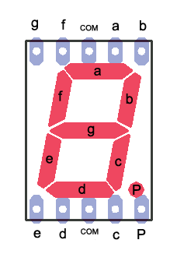
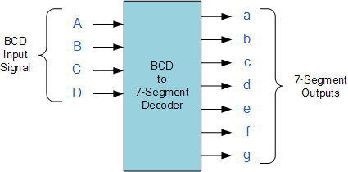
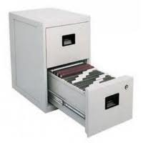

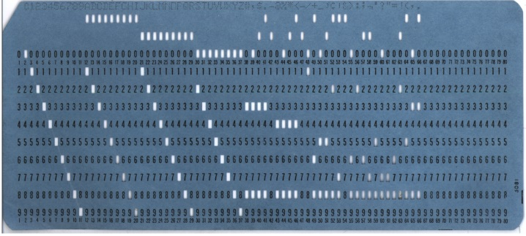
Additional Data Types
Data Types
Proposed C fixed-point
ISO/IEC 9899:1999
#include <stdfix.h>
_Fract, _Accum
TI: UQ8.8
bool (added to C in 1999)
enums
Complex
BCD
EBCDIC

Slide 53
MSP430 C Variable Data Types
C
Type | Size | Representation | Minimum | Maximum
char, signed char | 8 bits | ASCII | -128 | 127
unsigned char | bool 8 bits | ASCII | 0 | 255
short, signed short | 16 bits | 2's complement | -32768 | 32767
unsigned short | 16 bits | Binary | 0 | 65535
int, signed int | 16 bits | 2's complement | -32768 | 32767
unsigned int | 16 bits | Binary | 0 | 65535
long, signed long | 32 bits | 2's complement | -2,147,483,648 | 2,147,483,647
unsigned long | 32 bits | Binary | 0 | 4,294,967,295
enum | 16 bits | 2's complement | -32768 | 32767
float | 32 bits | IEEE 32-bit | 1.175495e-38 | 3.4028235e+38
double | 32 bits | IEEE 32-bit | 1.175495e-38 | 3.4028235e+38
long double | 32 bits | IEEE 32-bit | 1.175495e-38 | 3.4028235e+38
pointers, references | 16 bits | Binary | 0 | 0xFFFF
function pointers | 16 bits | Binary | 0 | 0xFFFF

Slide 54
Data Storage
Word size is the natural unit of data used by a particular computer design and usually refers to:
Size of registers
Amount of data transferred to/from memory in single operation
Largest possible address
Number of bits processed in a single operation
Base word size (Intel 32/64 bit, MPS430 is 16-bits)
When accessing/storing a 16-bit
word, the least significant byte
is first (lower) in memory.
Little and Big Endian
Storage order for larger data types
Little endian – least significant bits stored first (lower address)
Address | 0x0200 | 0x0201 | 0x0202 | 0x0203 | …
Little endian: | 0x34 | 0x12 | 0x78 | 0x56 | …
Big endian: | 0x12 | 0x34 | 0x56 | 0x78 | …
0x1234, 0x5678
0x34 0x12
0x12 0x34

Slide 55
Data Alignment / Padding
Data structure alignment is the way data is arranged and accessed in computer memory.
Data alignment and data structure padding. When a modern computer reads from or writes to a memory address, it will do this in word sized chunks (e.g. 4 byte chunks on a 32-bit system) or larger. Data alignment means putting the data at a memory offset equal to some multiple of the word size, which increases the system's performance due to the way the CPU handles memory.
To align the data, it may be necessary to insert some meaningless bytes between the end of the last data structure and the start of the next, which is data structure padding.

Slide 56
Type Casting
In binary operations (e.g., +, -, /, etc.) with operands of mixed data types, the resultant data type will take the higher order data type of the two operands¹
Data type conversion
Casting – explicitly convert a variable (expression) from one data type to another data type.
Promotion or data coercion – implicitly change a “smaller” data type into a “larger” data type.
Higher
long double
double
float
unsigned long long
long long
unsigned long
long
unsigned int
int
unsigned short
short
unsigned char
char
Lower

Slide 57
Choosing a Data Type
Loop counter
Gender
# of CD’s
Sound amplitude
Pi
GPA
GPS Coordinates
Bank account
Message
Population
Real numbers (physical)
unsigned int
Boolean, char, int
unsigned int
int (2’s complement)
float
Fixed point
float
int, Fixed point
ASCI Text
int
float

Slide 58

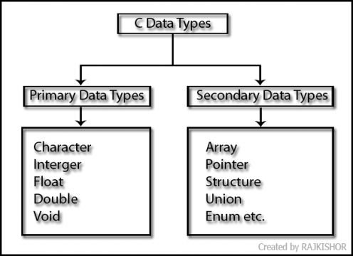
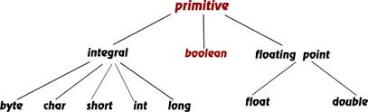
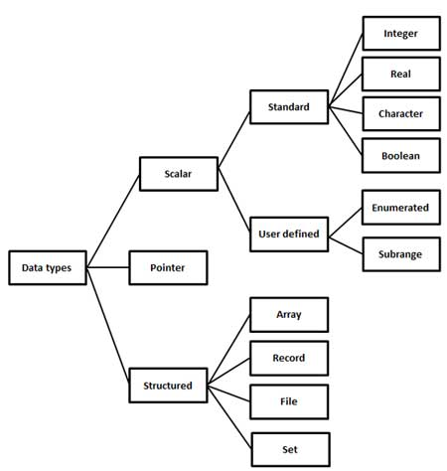
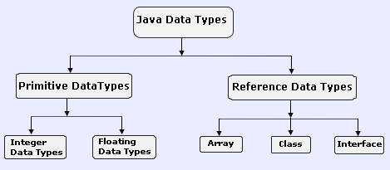
Summary / Review

Slide 59
Review: Representation
Review
Everything is stored in memory as one’s and zero’s
integers, floating point numbers, characters
program code
Data Type = Representation + Operations
You can’t tell what is what just by looking at the binary representation
memory could have multiple meanings
it is possible to execute your Word document

Slide 60
Review: Integral Numbers…
Review
Signed Magnitude
1’s Complement
2’s Complement
Un-signed
7
6
5
4
3
2
1
0
-1
-2
-3
-4
111
110
101
100
011
010
001
000
011
010
001
000, 100
101
110
111
011
010
001
000, 111
110
101
100
011
010
001
000
111
110
101
100
Range:
0 to 7
-3 to 3
-3 to 3
-4 to 3

Slide 61
Review: Fractional Numbers…
Review
Fixed Point
Bounded, whole/fraction
Positional 2’s complement
Integral binary operations
Floating Point
Unbounded, Sign-magnitude
IEEE 754 standard
Normalized, implied 1
Exponent biased by 127
Special ±infinity, zero, NaN
Range: ±1.18 × 10⁻³⁸ to ±3.4 × 10³⁸
-2⁷
2⁶
2⁵
2⁴
2³
2²
2¹
2⁰
2⁻¹
2⁻²
2⁻³
2⁻⁴
2⁻⁵
2⁻⁶
2⁻⁷
2⁻⁸
0
0
0
1
0
1
1
1
1
0
1
1
0
0
0
0
Whole or integral Part
Fractional Part
1
8
23
s
exponent
fraction
N = -1^{s} × 1.fraction × 2^{(exponent – 127)}

Slide 62
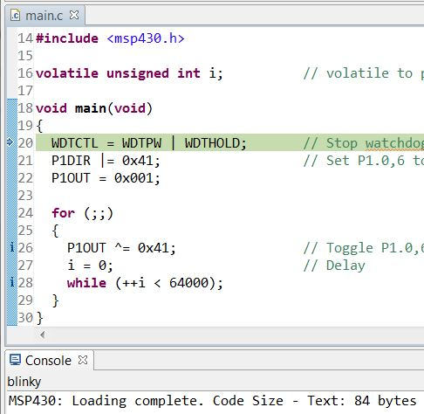
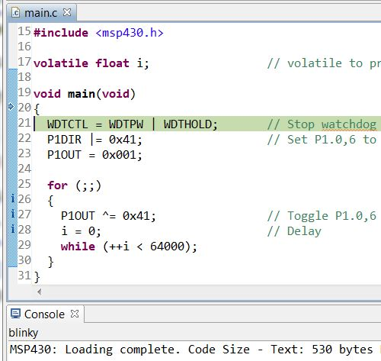
float's vs int's
Review

Slide 63
Quiz 1.7
00000110 (signed magnitude)
+ 10001101 (signed magnitude)
(signed magnitude)
(1’s complement)
+ 00000010 (1’s complement)
(1’s complement)
(2’s complement)
+ 00100101 (2’s complement)
(2’s complement)
(decimal₁₀)

Slide 64
